Slide 1
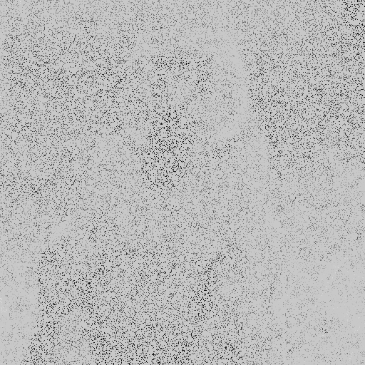

Image Completion 1.0
Our program using Randomized SVD can recover an image with scarce pixels.

Slide 2
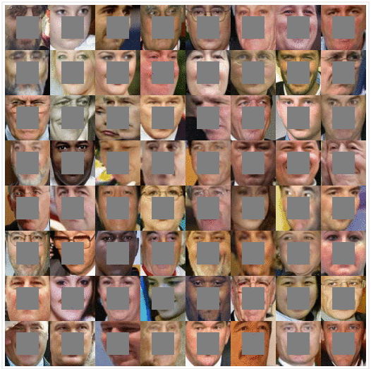
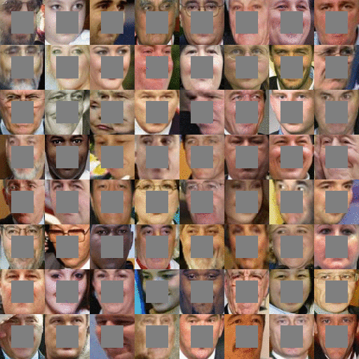
Image Completion 2.0
Image Completion with DCGAN: http://bamos.github.io/2016/08/09/deep-completion/

Slide 3
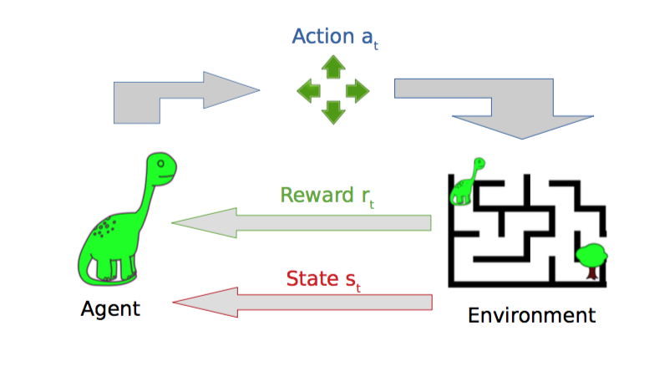
Reinforcement Learning
Reinforcement Learning
An environment which provides numeric reward signals
Learn how to take actions to maximize reward
Reinforcement Learning requires many trials
Works well in games and virtual reality
Often does not work in real world

Slide 4
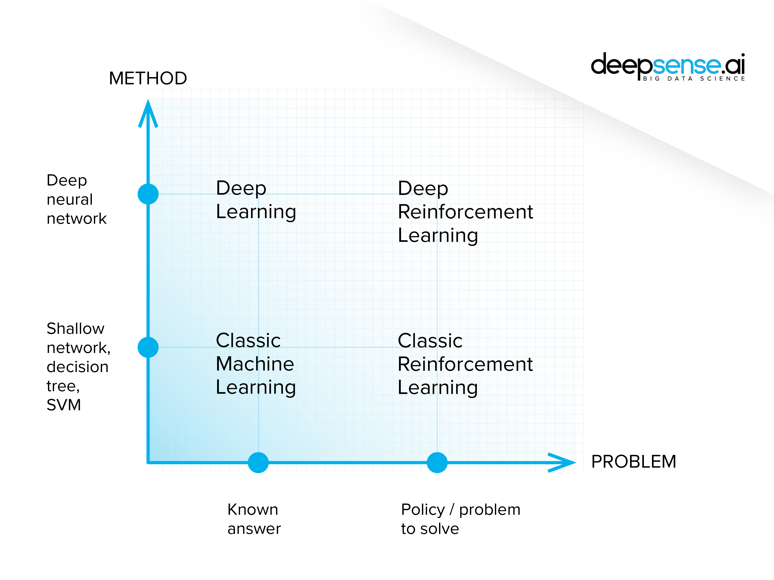
Reinforcement Learning and Machine Learning

Slide 5
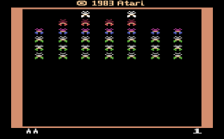
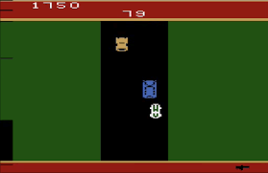
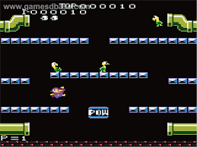
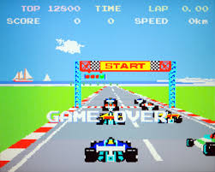
Atari Games
Goal: Complete the game with the highest score
State: Raw pixel inputs of the game state
Actions: Pressing Game control keys. Left, Right, Up, Down, A, B, …
Reward: Score increase/decrease at each step

